Slide 1

Class7
CSC 495/583 Topics of Software Security Stack Overflow (2)
Dr. Si Chen (schen@wcupa.edu)

Slide 2
Review

Slide 3
Stack Frame

Slide 4
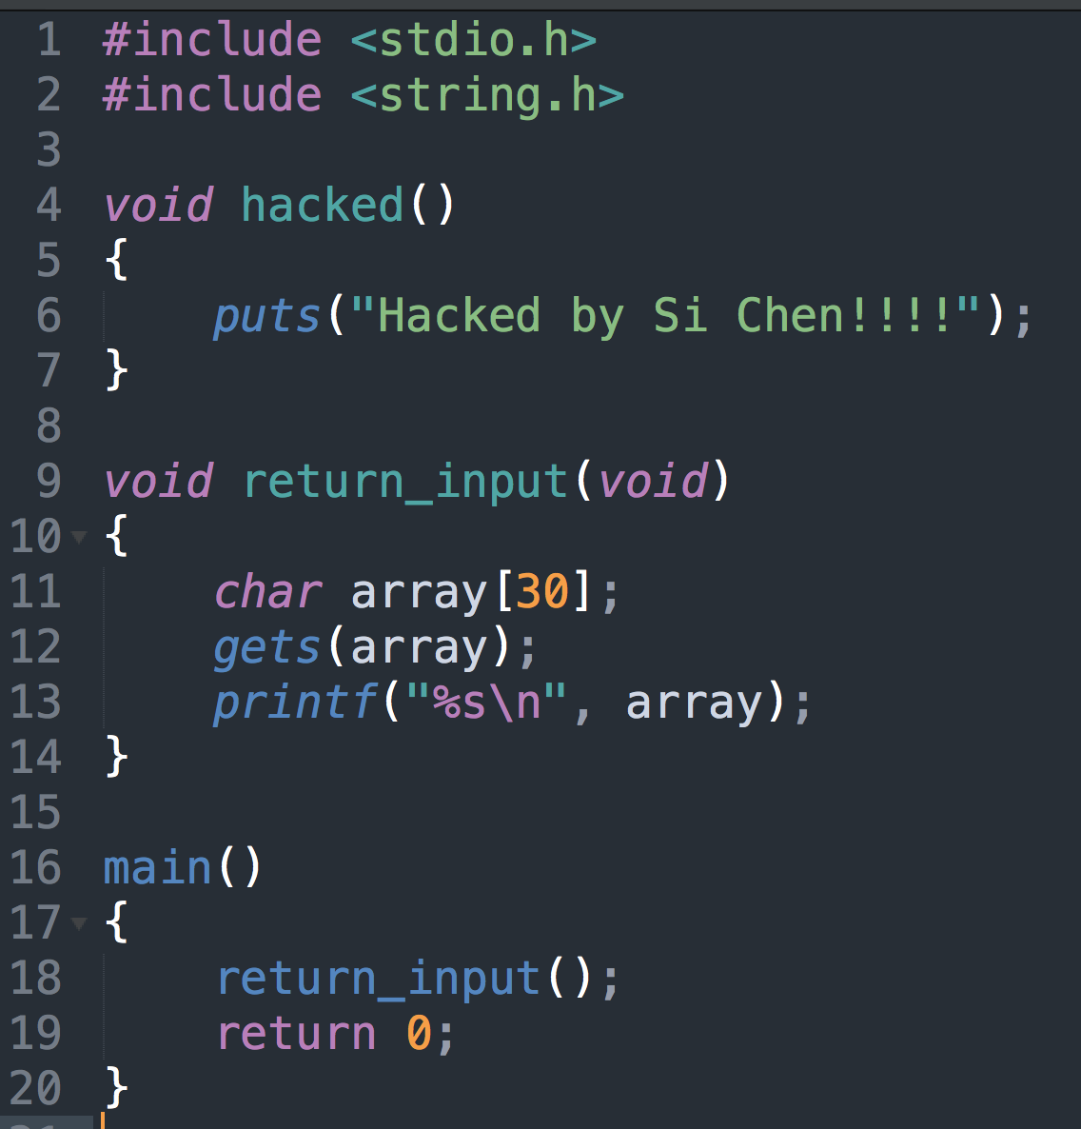
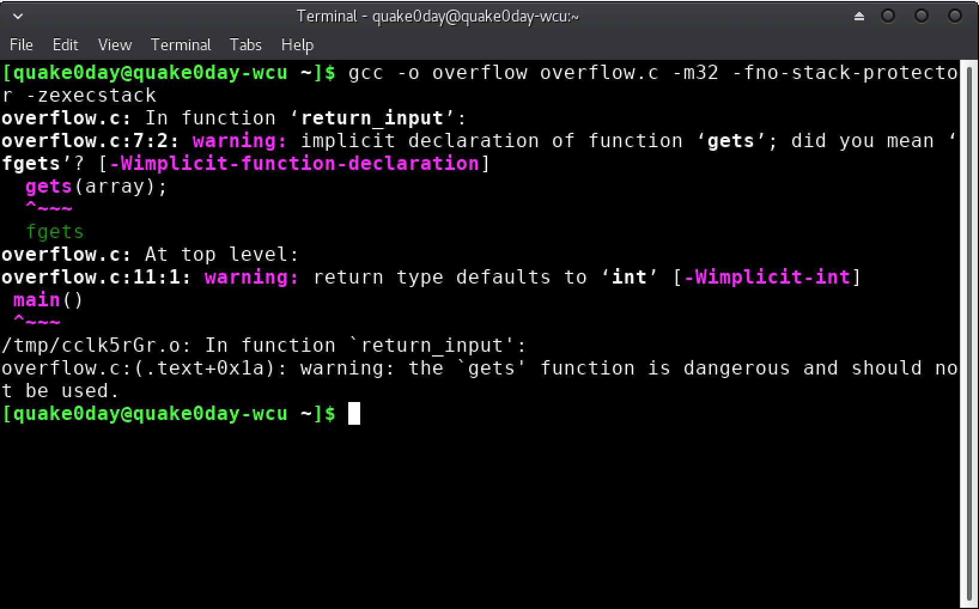
Overflow.c

Slide 5
Protection: ASLR, DEP, Stack Protector
Shutdown ASLR (Address space layout randomization)
-fno-stack-protector Shutdown stack protector
-z execstack Shutdown DEP(Data Execution Prevention)

Slide 6
Bug → Vulnerability
Step 1. Fine the vulnerability
Read & read & read the code (code audit)
Fuzz testing
Crash
Output some info that shouldn’t been output

Slide 7
Bug → Vulnerability
Step 2. Control-flow Hijack
Try to change the flow of the program
Change the return address
Change the function pointer, so the behavior of the will change when called
Change the variable, change the behavior of the function (e.g. uid = 0)

Slide 8
Bug → Vulnerability
Step 3. Execute Payload
Launch the attack
Open a shell
Read/write file/data
Implement backdoor…

Slide 9
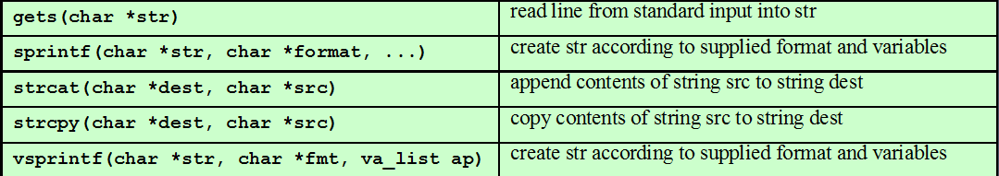
Buffer Overflow
Common Unsafe C Functions

Slide 10
Return Hijack
The return address will be stored on stack when calling a new function. (EIP)
The local valuable will be store on the low address
If the variable is an array, and if we store too many data, it will cover the return address which store on the high address.

Slide 11
From Crash to Hack
If the input is larger than the size of the array, normally, the program will crash.
Need to craft special data to exploit this vulnerability.
The general idea is to overflow a buffer so that it overwrites the return address.
AAAA
AAAA
BBBB
BBBB
CCCC
CCCC
DDDD
New Return Address

Slide 12
Jump to Shellcode
When the function is done it will jump to whatever address is on the stack.
We put some code in the buffer and set the return address to point to it!
Small Program
New Return Address

Slide 13
How?
How do we know what value the pointer should have (the new “return address”).
It’s the address of the buffer, but how do we know what address this is?
How do we build the “small program” and put it in a string?
Small Program
New Return Address

Slide 14
Guessing Addresses
Typically you need the source code so you can estimate the address of both the buffer and the return-address.
An estimate is often good enough! (more on this in a bit).

Slide 15
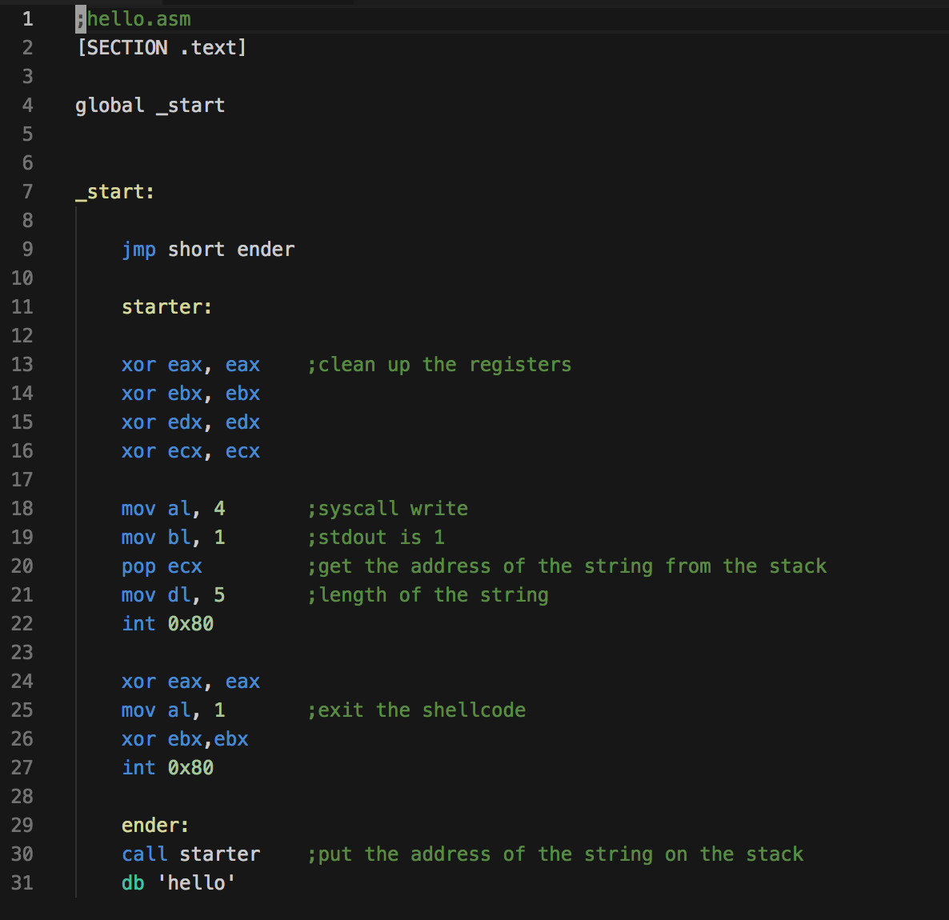
Crafting Shellcode (the small program)
Example: Hello World
hello.asm

Slide 16
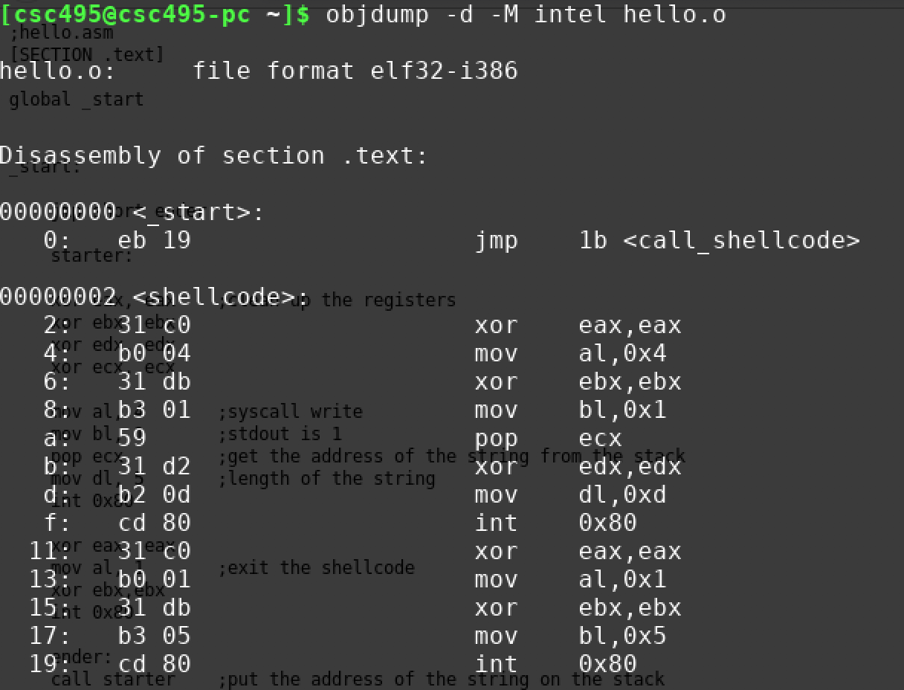
Crafting Shellcode (the small program)
Example: Hello World
To compile it use nasm:
Use objdump to get the shellcode bytes:

Slide 17
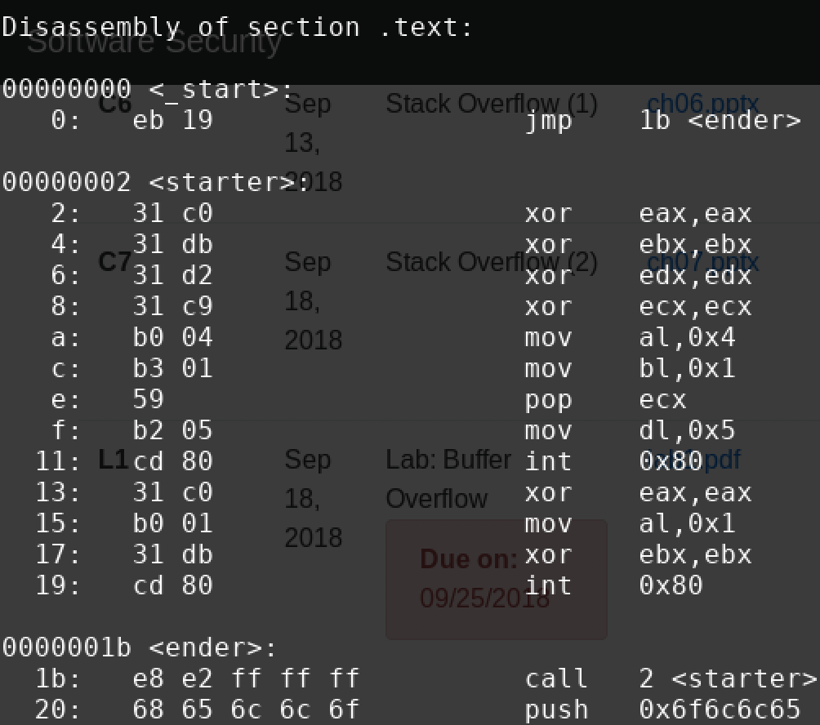
Crafting Shellcode (the small program)
Extracting the bytes gives us the shellcode:
\xeb\x19\x31\xc0\x31\xdb\x31\xd2\x31\xc9\xb0\x04\xb3\x01\x59\xb2\x05\xcd\x80\x31\xc0\xb0\x01\x31\xdb\xcd\x80\xe8\xe2\xff\xff\xff\x68\x65\x6c\x6c\x6f

Slide 18
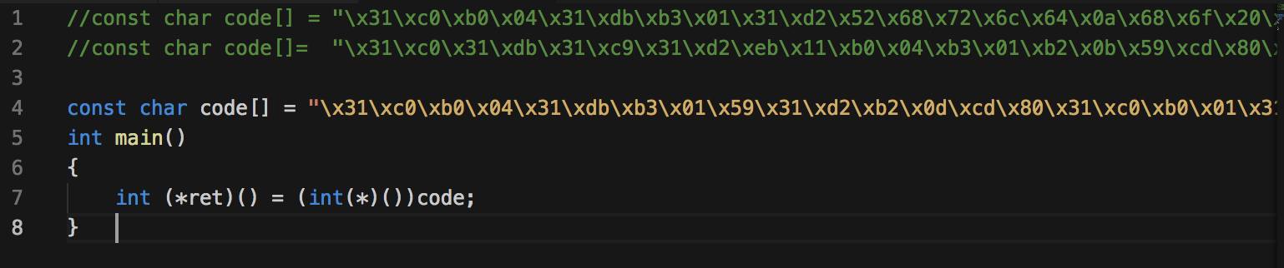
Test Shellcode (the small program)

Slide 19
Crafting Shellcode (the small program)
Example: launch a shell
shellcode.asm

Slide 20
Crafting Shellcode (the small program)
Example: launch a shell
To compile it use nasm:
shellcode.asm
Use objdump to get the shellcode bytes:

Slide 21
Finding a possible place to inject shellcode
Small Program
\xeb\x19\x31\xc0\x31\xdb\x31\xd2\x31\xc9\xb0\x04\xb3\x01\x59\xb2\x05\xcd\x80\x31\xc0\xb0\x01\x31\xdb\xcd\x80\xe8\xe2\xff\xff\xff\x68\x65\x6c\x6c\x6f
New Return Address

Slide 22
Finding a possible place to inject shellcode
Small Program
\xeb\x19\x31\xc0\x31\xdb\x31\xd2\x31\xc9\xb0\x04\xb3\x01\x59\xb2\x05\xcd\x80\x31\xc0\xb0\x01\x31\xdb\xcd\x80\xe8\xe2\xff\xff\xff\x68\x65\x6c\x6c\x6f
Use GDB to figure out the memory address of the beginning of the buffer
New Return Address

Slide 23
NOP slide

Slide 24
NOP slide
Using NOPs
Most CPUs have a No-Operation instruction – it does nothing but advance the instruction pointer.
Usually we can put a bunch of these ahead of our program (in the string).
As long as the new return-address points to a NOP we are OK.

Slide 25
NOP slide
\x90\x90\x90\x90\x90\x90\x90\x90\x90\x90\x90\x90\x90\x90\x90\x90\x90
Small Program
\xeb\x19\x31\xc0\x31\xdb\x31\xd2\x31\xc9\xb0\x04\xb3\x01\x59\xb2\x05\xcd\x80\x31\xc0\xb0\x01\x31\xdb\xcd\x80\xe8\xe2\xff\xff\xff\x68\x65\x6c\x6c\x6f
New Return Address

Slide 26
Estimating the stack size
We can also guess at the location of the return address relative to the overflowed buffer.
Put in a bunch of new return addresses!

Slide 27
Estimating the Location
\x90\x90\x90\x90\x90\x90\x90\x90\x90\x90\x90\x90\x90\x90\x90\x90\x90
\xeb\x19\x31\xc0\x31\xdb\x31\xd2\x31\xc9\xb0\x04\xb3\x01\x59\xb2\x05\xcd\x80\x31\xc0\xb0\x01\x31\xdb\xcd\x80\xe8\xe2\xff\xff\xff\x68\x65\x6c\x6c\x6f
Small Program
New Return Address
New Return Address
New Return Address

Slide 28
Protection: ASLR, DEP, Stack Protector
Shutdown ASLR (Address space layout randomization)
-fno-stack-protector Shutdown stack protector
-z execstack Shutdown DEP(Data Execution Prevention)

Slide 29
Protection: ASLR, DEP, Stack Protector
Address Space Layout Randomization (ASLR) is a technology used to help prevent shellcode from being successful.
It does this by randomly offsetting the location of modules and certain in-memory structures.

Slide 30
Protection: ASLR, DEP, Stack Protector
Data Execution Prevention (DEP) prevents certain memory sectors, e.g. the stack, from being executed.
Stack protection will abort your program if it detects stack overflow.
That’s why I failed last time ….
Bypassing ASLR/DEP - exploit-db

Slide 31
StackGuard
Insert Canary before the function being called.\
Check this value to see if it been tweaked
Cowan, Crispan, et al. "Stackguard: automatic adaptive detection and prevention of buffer-overflow attacks." USENIX Security Symposium. Vol. 98. 1998.
https://www.usenix.org/legacy/publications/library/proceedings/sec98/full_papers/cowan/cowan.pdf

Slide 32
StackGuard: Stack Reading
Overflow one more byte and try every possible value
If no crash → success
Crash → wrong guess

Slide 33
StackGuard: Overwrite Local Variable
Overwrite local variable → does not cover Canary
Use the local variables to hack the memory
Local Variable 1
Local Variable 2

Slide 34
ELF executable

Slide 35
ELF executable for Linux
Executable and Linkable Format (ELF)
Linux | Windows
ELF file | .exe (PE)
.so (Shared object file) | .dll (Dynamic Linking Library)
.a | .lib (static linking library)
.o (intermediate file between complication and linking, object file) | .obj

Slide 36
ELF executable for Linux
ELF32-bit LSB
Dynamically linked

Slide 37
Shared library
ELF is loaded by ld-linux.so.2 → in charge of memory mapping, load shared library etc..
You can call functions in libc.so.6

Slide 38
Q & A

